Slide 1
EMPLOYEE MANAGEMENT SYSTEM PROJECT
Done by:
816312-Aravind Balakrishnan
816288 –Aswanth B

Slide 2
INTRODUCTION
This Employee Management System Project application stores all the employee’s information in a database. It is an application developed in Java, Spring boot technology and database used is MYSQL.
It contains employee information like employee id, first name, surname, and age. It is an easy to use application and has a user-friendly interface. It is totally built at the administrative end which means that only the admin has access rights to change or modify any records. So this makes it safe and reliable application to use.
The main aim of developing this application was to reduce the errors that occur in the manual system. One can search the details easily by just entering employee id. In earlier systems, there was not such a facility to do so. All the details are stored in an SQLite database. It is easy to update any employee details. All the employee records are integrated and so this makes it user-friendly and easy to use application.

Slide 3
EXISTING SYSTEM
Earlier systems were manual where there was no way of properly storing information. Employee records were stored manually which lead to errors. There was no proper way of tracking employee records. It was very difficult and required a lot of paperwork which makes the application time consuming and not secured. There was no administrator which could handle the records. So there was the need to develop a system which could manage all these things and reduce the paperwork.

Slide 4
PROPOSED SYSTEM
Employee information system is easy to use application which is created to manage the employee data. It is created to record the details of the employees. This reduces the dependency on the manual system which could create errors.
This system can easily help in tracking employee records. There is a search feature which allows getting records of a specific employee. There is an administrator which can add, edit, delete and save records in a database.
There are two views for this application first is the administrator and the second is employee view. The employee view enables employees to view their details.

Slide 5
MODULES
Create module: used to create new employee.
Update module: used to update employee details
Search module: used to search for a employee’s details.
Delete module: used to delete employee.
Log in module: used for admin and employee log in
Log out module: used for admin and employee log out

Slide 6
TECHNOLOGIES USED
JAVA 17
MAVEN
SPRING 3.0.0 –M1
MYSQL 8.0
HTML
CSS

Slide 7
NOTES
The admin username=admin and password=password.
There are no values inserted at the database at start. You have to start inserting data to work with.
The application runs on port 8080 by default. You can change it in application.properties file.
The application connects to MySQL server. You have to provide your MySQL username ,password and database URL in applications.properties file.

Slide 8
HOME PAGE
The homepage requires no login to access it.
It contains a top nav bar to access admin home which requires admin access and a Employee Login .
It also contains a section with some details.

Slide 9
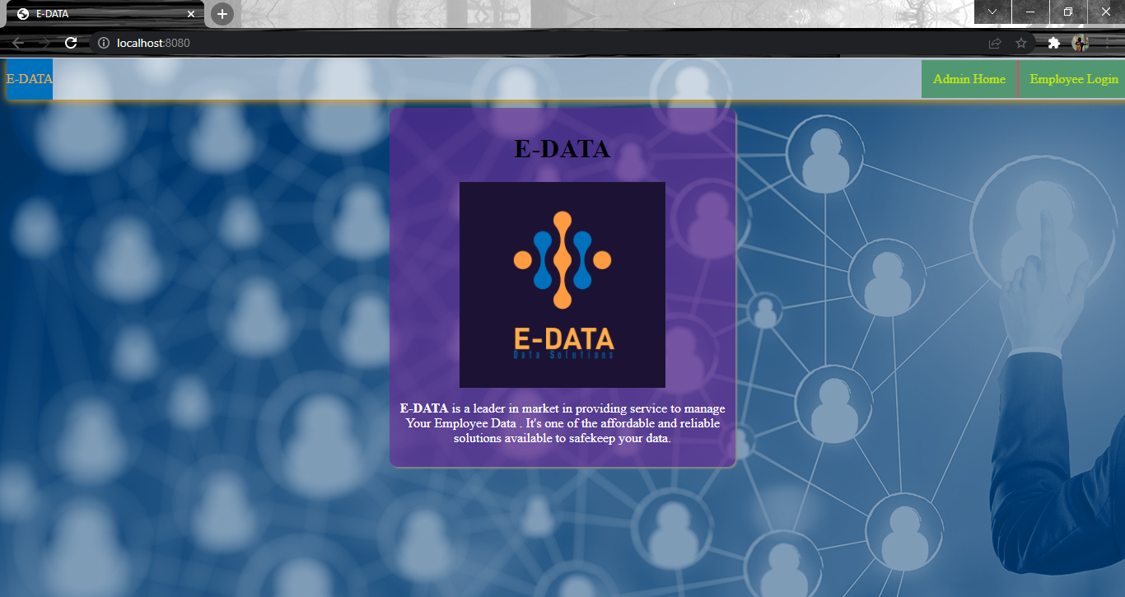
HOME PAGE( NO LOG IN REQUIRED)

Slide 10
ADMIN LOG IN
When you click on ADMIN HOME in the top nav bar it goes to the admin page which requires admin access to log in.
The sign in page takes username and password of admin to log in.
Upon successful log in it goes to the Admin Home page.
If the log in is not successful it shows bad credentials on the same page.

Slide 11
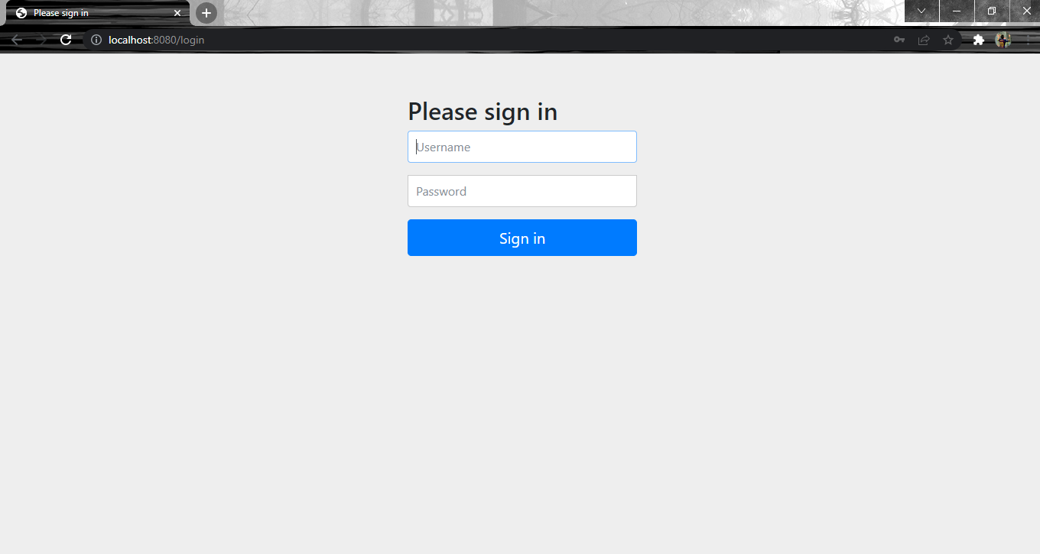
ADMIN LOG IN PAGE

Slide 12
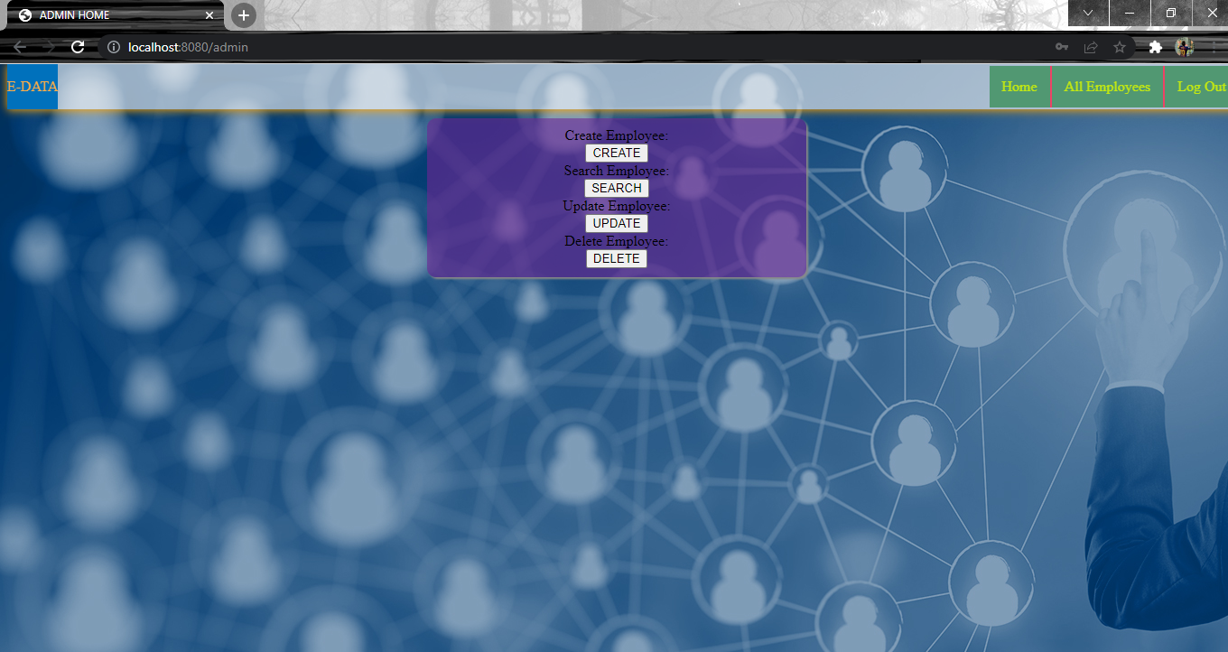
ADMIN HOME PAGE ON SUCCESSFUL LOG IN

Slide 13
ADMIN HOME PAGE
Only Admin has the rights to create, delete and update employee data.
The Admin home page provides all those options .
It also provide a search option to search the details of a particular employee.
The top nav bar in the admin home page has a link to all employee details. Which can be also only accessible by the admin.
The top nav bar has a logout option to log out the admin.

Slide 14
CREATING EMPLOYEE
When clicking on create employee option from admin home it goes to the create employee page.
The create employee page takes data like first name, last name, age, salary, designation of the employee.
In addition to that it also needs a dummy password which the admin needs to create at the time of employee creation which will be later changed by the employee on their first log in.
After inserting the employee it provides the message that the employee is created.

Slide 15
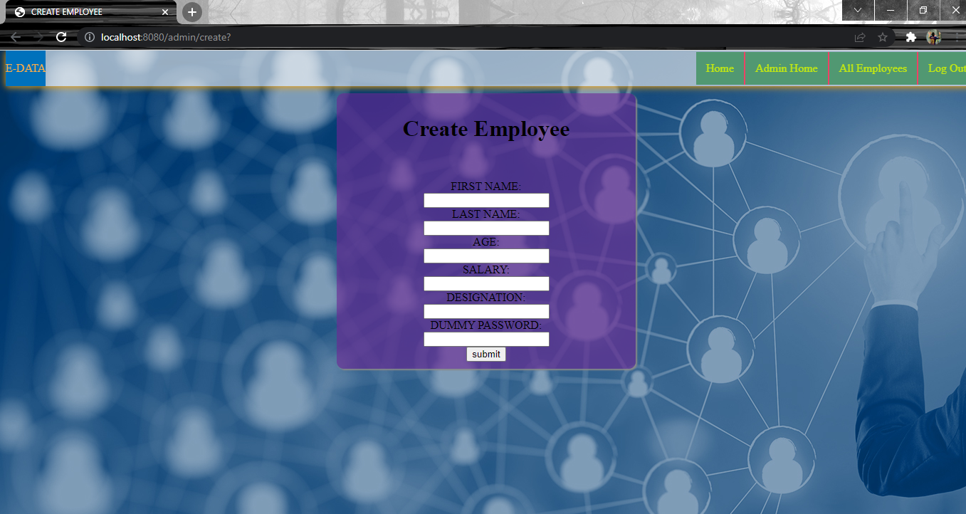
CREATE EMPLOYEE PAGE

Slide 16
UPDATE EMPLOYEE
When clicking the update employee option from admin home it goes to the update employee page.
It has options to update each details of the employee except for the password which can only be updated by the employee.

Slide 17
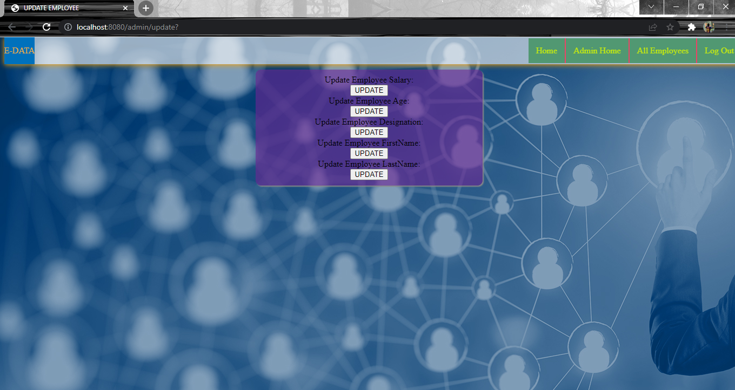
UPDATE EMPLOYEE PAGE

Slide 18
UPDATE EMPLOYEE SALARY
When clicking on update salary button from update employee page it goes to the update salary page.
It takes two details Id and New salary and assigns the new salary to the employee with that id.
If the employee is not found for the given id it shows a message employee not found.
If the salary is updated it shows a message as the salary is updated.

Slide 19
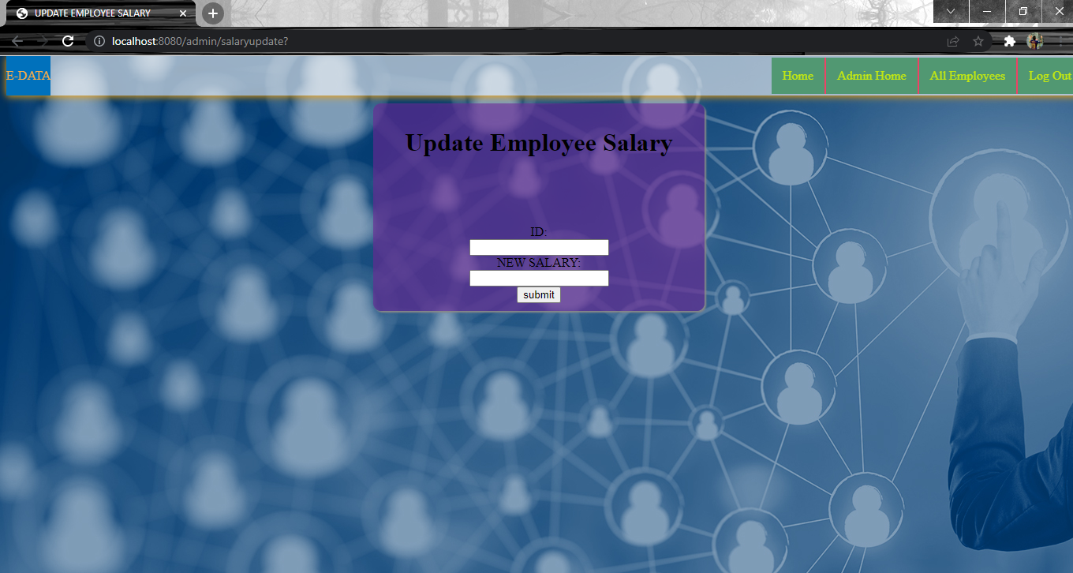
UPDATE EMPLOYEE SALARY PAGE

Slide 20
OTHER UPDATE EMPLOYEE OPTIONS
When clicking on other update options from update employee page it goes to it respective update page.
Those pages will take two details Id and New age/New designation/New First name / New Last name and assigns the respective values to the respective fields of the employee with that id same as the update salary page.
If the employee is not found for the given id those shows a message employee not found same as the update salary page.
If the values are updated those pages shows a message as the value is updated same as the update salary page.
Those pages will look and work as the update salary page.

Slide 21
SEARCH EMPLOYEE
The admin home has a search option which is used to search for a employee by id.
If the employee is not found for that id it gives a message as employee not found.
If the employee is found it goes to the details page which shows the employee details.

Slide 22
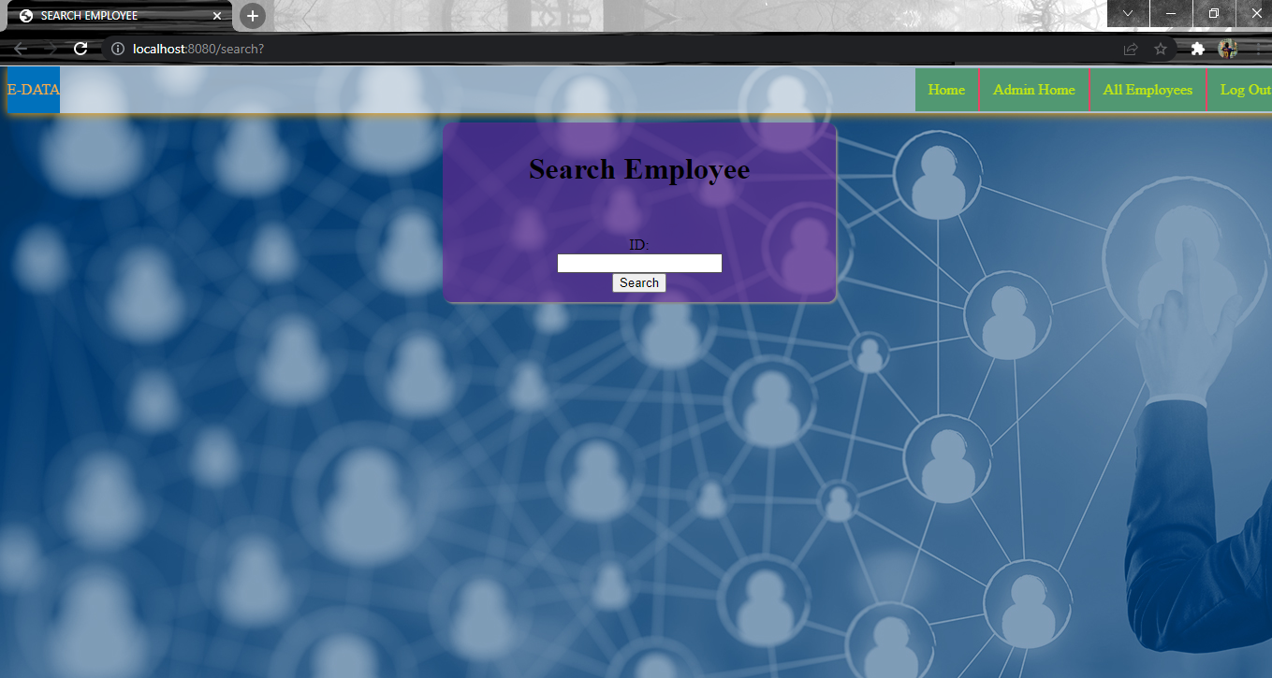
SEARCH EMPLOYEE PAGE

Slide 23
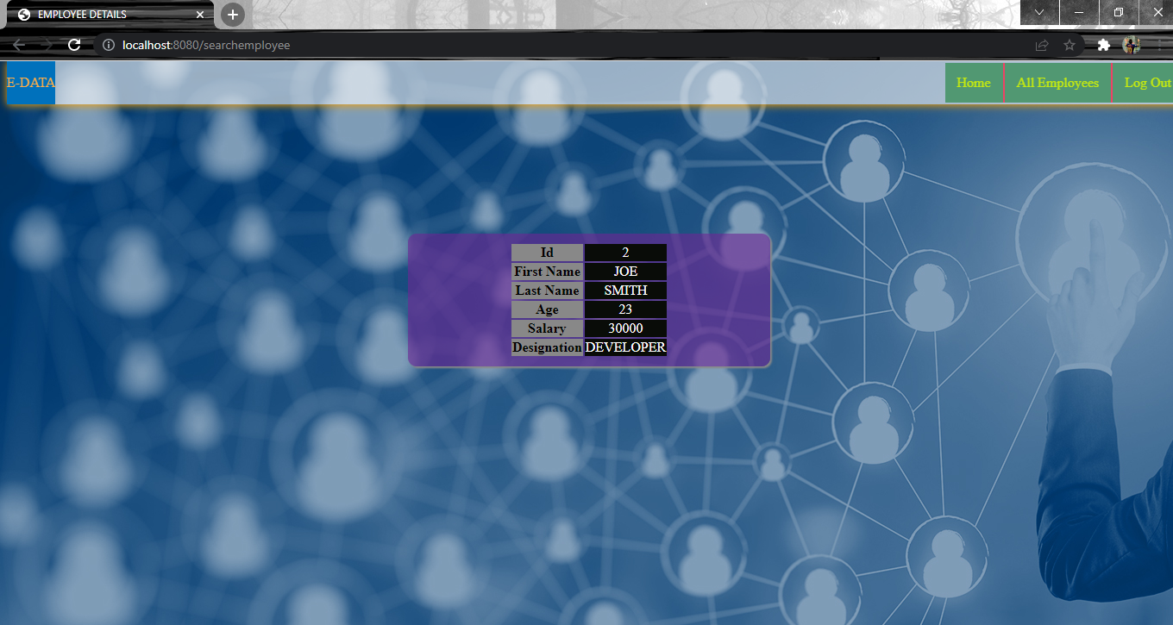
SEARCH EMPLOYEE DETAILS PAGE

Slide 24
EMPLOYEE LOG IN
The employees can log in to their account to see their details by clicking the employee log in option at home page.
If the employee is not found it will show a message employee not found.
A dummy password for employee will be created by the admin when the employee is created. The employee has to get his dummy password from the admin.
When the employee logs in for the first time using the dummy password they will be automatically redirected to a change password page. After changing password for the first time he can use that password to log in again from the homepage to see his details.

Slide 25
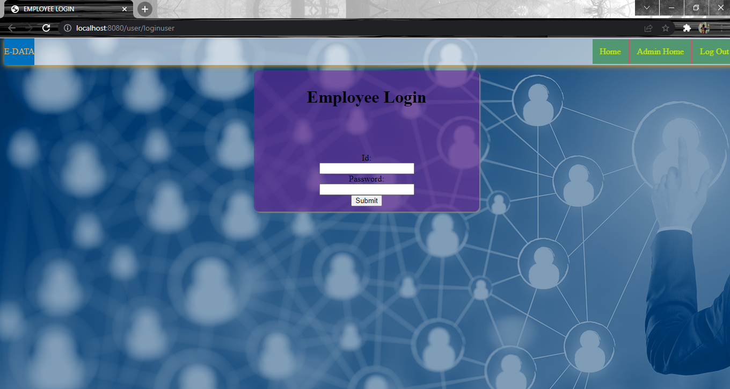
EMPLOYEE LOG IN PAGE

Slide 26
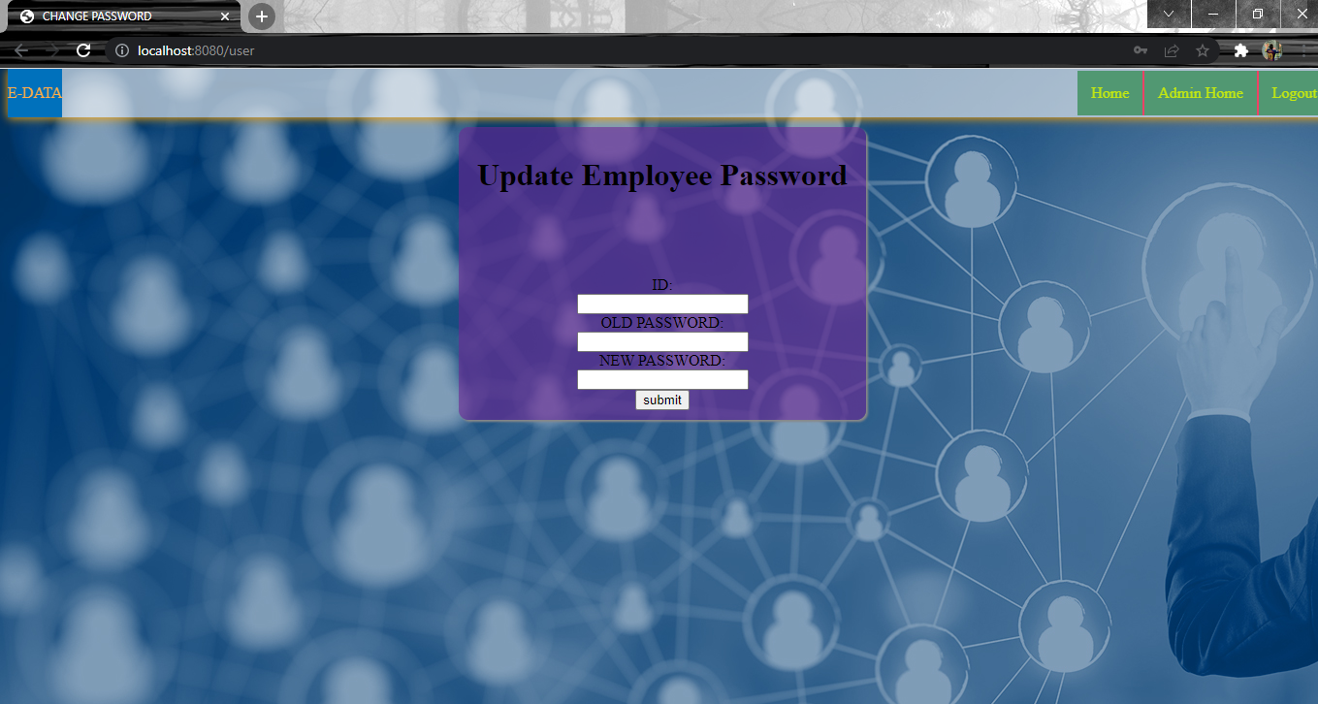
AUTOMATIC REDIRECTION TO PASSWORD CHANGE PAGE ON FIRST LOG IN

Slide 27
EMPLOYEE LOGIN AFTER FIRST LOG IN
After changing the password on first login the employee can log in using the same log in option in homepage this time it will show the user details.
It has also a option to change the password which will go to the password change page.

Slide 28
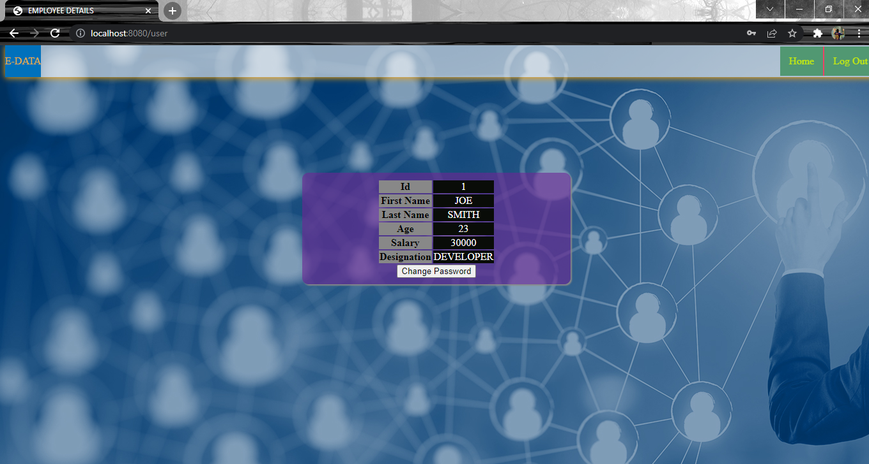
EMPLOYEE LOGGING IN AFTER FIRST LOG IN

Slide 29
ALL EMPLOYEES PAGE
All employees details can be accessed by going to the all employees option in the admin home or any page that has admin access only.

Slide 30
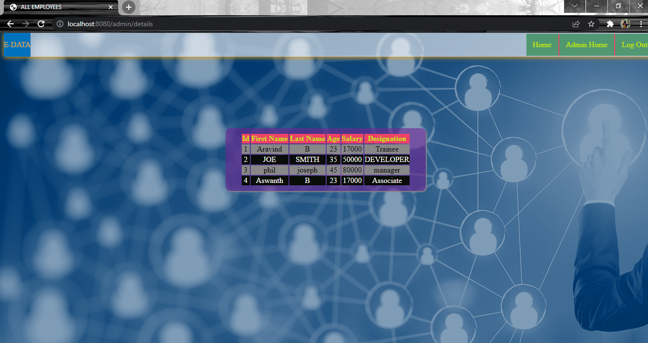
ALL EMPLOYEES’ DETAILS

Slide 31
LOG OUT
The admin or the employees can log out using the log out option in the top nav bar to log out once they are logged in.
The log out option will log out the employee/admin and will return to home page.

Slide 32
CONCLUSION
Thus the employee management system which is used to store the employee details in a database using spring, java, MySQL is developed with main aim of developing this application was to reduce the errors that occur in the manual system and reduce the time consumed.
This application is developed in a user-friendly, easy to use and error free manner.

